Slide 1
Development For Measure Energy Consumption
Data Collection: First, you need to obtain a dataset related to energy consumption. This dataset could come from various sources, such as smart meters, IoT devices, or publicly available datasets. Ensure you have the necessary permissions to use the data.
Data Loading: Import the dataset into your project. The data might be in various formats, such as CSV, Excel, or a database. Use appropriate libraries or tools to load the data into your project environment. For example, in Python, you can use Pandas to read CSV files.
Data Exploration: Start by exploring the dataset to understand its structure. Check for columns, data types, and any initial insights about energy consumption patterns. You can use Pandas for basic data exploration.
Data Preprocessing: Preprocess the dataset to clean and prepare it for analysis. This may involve handling missing values, removing duplicates, and converting data types.
Additionally, you might want to create new features or aggregate data if necessary.
Time Series Data: If your dataset involves time series data (e.g., hourly energy consumption), consider resampling, smoothing, or aggregating the data to a suitable granularity for your analysis.
Data Visualization: Create visualizations to gain insights into energy consumption trends and patterns. Matplotlib or Seaborn can help with data visualization in Python.
Feature Engineering: Depending on your project goals, engineer features that may help in modeling energy consumption more effectively. For example, you could create features that capture time-of-day patterns, day of the week, or seasonality.
Data Splitting: If you're building a predictive model, split the dataset into training and testing sets. This is important for model evaluation.
Save Preprocessed Data: Save the preprocessed data, so you don't need to repeat these steps every time you run your project. You can use Pandas to save data to CSV or another format.
Once you've completed these steps, you'll be ready to proceed with your project, whether it involves building predictive models, analyzing energy consumption patterns, or any other specific goals you have in mind. If you have a more specific dataset or project in mind, feel free to provide more details, and I can offer more tailored advice.
Program
# Input: Sample daily energy consumption data energy_data = [

Slide 2
{'date': '2023-10-01', 'consumption_kWh': 100},
{'date': '2023-10-02', 'consumption_kWh': 120},
{'date': '2023-10-03', 'consumption_kWh': 90}, # Add more data points here
]
# Output: Calculate average daily energy consumption def calculate_average_consumption(data):
total_consumption = 0 for entry in data:
total_consumption += entry['consumption_kWh'] num_entries = len(data)
average_consumption = total_consumption / num_entries return average_consumption
# Main program
if name == " main ":
average_daily_consumption = calculate_average_consumption(energy_data) print("Average Daily Energy Consumption: {:.2f}
kWh".format(average_daily_consumption))

Slide 3
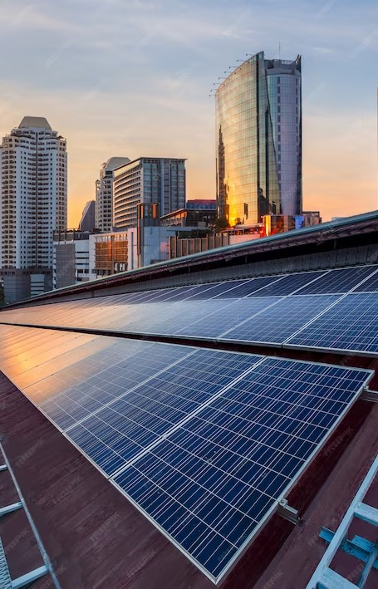
Development For Measure Energy Consumption

Slide 4

Powering up E ciency
Welcome to our presentation on energy consumption measurement! Today, we'll be exploring the secrets of measuring and optimizing energy usage to improve efﬁciency and reduce
costs.

Slide 5

Tools for Measuring Energy Consumption
There are many tools available for measuring energy consumption, including smart meters, submeters, and energy management systems. These tools can provide real-time data on energy usage and help identify areas for improvement. By using these tools, we can gain a better understanding of our energy consumption and make informed decisions to optimize efﬁciency.

Slide 6

Optimizing Energy Consumption
Once we have identiﬁed areas for improvement, we can implement changes to optimize energy consumption. This can include upgrading equipment, implementing energy-efﬁcient practices, and adjusting schedules to reduce energy usage during peak hours. By optimizing energy consumption, we can reduce costs and improve our environmental impact.

Slide 7
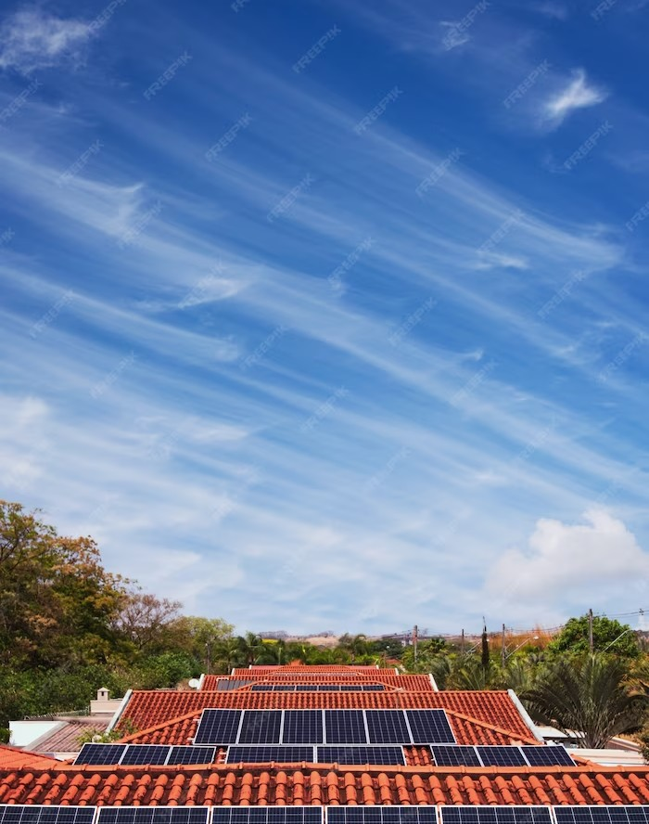
Case Study: Energy E ciency in Manufacturing
In this case study, we'll explore how a manufacturing company implemented energy- efﬁcient practices to reduce costs and improve efﬁciency. By implementing changes such as upgrading equipment and optimizing schedules, the company was able to reduce energy usage by 20% and save $100,000 annually.

Slide 8
Conclusion
By measuring and optimizing energy consumption, we can improve efﬁciency, reduce costs, and have a positive impact on the environment. With the right tools and practices in place, we can unlock the secrets of energy consumption measurement and power up our efﬁciency!

